Slide 1
SQL: Structured Query Language
An introduction and live demo

Slide 2
What is SQL?
SQL is the standard language used to manipulate databases
  Supported by all relational database management systems, such as MySQL, DB2, Oracle, and many others.
Some common commands
  Create
  Update
  Delete
  Select
  Insert
  Drop

Slide 3
Common data types
INT: Integer --- 4 bytes
CHAR(x): Fixed length character for exactly x bytes; padding with space when the string is shorter than x
VARCHAR(x): Variable length character of x bytes; maximum number of bytes is x
BLOB: a binary large object data type; used for storing images, object code, binary file
TEXT: Large textual data for storing text documents
FLOAT: Single precision floating point
DOUBLE: Double precision floating point
DECIMAL(M, D): M total number of digits, d the number of digits on the right hand side of the decimal point
DATE; Default date format is yyyy-mm-dd
TIME
DATETIME

Slide 4
Create a table
Students table
Attribute, type and length:
snum: integer,
ssn: integer,
name: varchar(10),
gender: varchar(1),
dob: date,
addr: varchar(20),
phone: varchar(10),
Primary key: ssn
CREATE TABLE table_name (
column_1 datatype,
column_2 datatype,
column_3 datatype
);
CREATE TABLE Students (
snum int,
ssn int,
name varchar(10),
gender varchar(1),
dob date,
addr varchar(20),
phone varchar(10),
PRIMARY KEY (ssn)
);

Slide 5
Foreign keys
Employee(eid: integer, ename: string, salary: real)
Department(did: integer, dname: string, budget: real, managerid: integer); managerid is a foreign key to Emp
Works(eid: integer, did: integer, pct_time: integer)
Eid is a foreign key to Employee and did is a foreign key to Department

Slide 6
Foreign keys
CREATE TABLE Department (
did int,
dname varchar(25),
budget float,
managerid int
PRIMARY KEY (did),
FOREIGN KEY (managerid) REFERENCES Employee(eid));
CREATE TABLE Employee (
eid int,
ename varchar(25),
salary float,
PRIMARY KEY (eid));
CREATE TABLE Works (
eid int,
did int,
pct_time int,
PRIMARY KEY (eid, did),
FOREIGN KEY (eid) REFERENCES Employee(eid),
FOREIGN KEY (did) REFERENCES Department(did));

Slide 7
Maintaining referential integrity
What to do if deleting a tuple in one relation with other tuples referring to it?
SQL supports all 4 options on deletes and updates.
Default is NO ACTION (delete/update is rejected)
CASCADE (also delete all tuples that refer to the deleted tuple)
SET NULL / SET DEFAULT (sets the foreign key value of referencing tuple)
CREATE TABLE Enrolled
(sid CHAR(20),
cid CHAR(20),
grade CHAR(2),
PRIMARY KEY (sid, cid),
FOREIGN KEY (sid) REFERENCES Students(sid)
ON DELETE CASCADE);
CREATE TABLE Enrolled
(sid CHAR(20),
cid CHAR(20),
grade CHAR(2),
PRIMARY KEY (sid, cid),
FOREIGN KEY (sid) REFERENCES Students(sid)
ON DELETE SET NULL);
Not all DBMS implements SET DEFAULT

Slide 8
Unique and NOT NULL
CREATE TABLE Works (
eid int,
did int,
pct_time int NOT NULL,
PRIMARY KEY (eid, did),
FOREIGN KEY (eid) REFERENCES Employee(eid),
FOREIGN KEY (did) REFERENCES Department(did));
CREATE TABLE Department (
did int,
dname varchar(25) NOT NULL UNIQUE,
budget float NOT NULL,
managerid int
PRIMARY KEY (did),
FOREIGN KEY (managerid) REFERENCES Employee(eid));

Slide 9
Alter and Drop a table
ALTER TABLE table_name
ADD column_name datatype;
ALTER TABLE Students
ADD email varchar(30);
ALTER TABLE table_name
DROP COLUMN column_name;
ALTER TABLE Students
ADD COLUMN dob;
ALTER TABLE table_name
MODIFY COLUMN column_name datatype;
ALTER TABLE Students
MODIFY COLUMN dob datetime;
DROP TABLE table_name;
DROP TABLE Students;

Slide 10
Insert tuple
INSERT INTO table_name (column1, column2, column3, ...)
VALUES (value1, value2, value3, ...);
INSERT INTO students (snum, ssn, name, gender, dob, addr, phone)
VALUES
(1001, 654651234, 'Randy', 'M', '2000-12-01', '301 E Hall', '5152700988'),
(1002, 123097834, 'Victor', 'M', '2000/05/06', '270 W Hall', '5151234578'),
(1003, 978012431, 'John', 'M', '1999/07/08', '201 W Hall', '5154132805'),
(1004, 746897816, 'Seth', 'M', '1998/12/30', '199 N Hall', '5158891504'),
(1005, 186032894, 'Nicole', 'F', '2001/04/01', '178 S Hall', '5158891155'),
(1006, 534218752, 'Becky', 'F', '2001/05/16', '12 N Hall', '5157083698'),
(1007, 432609519, 'Kevin', 'M', '2000/08/12', '75 E Hall', '5157082497');

Slide 11
Modify tuple
UPDATE table_name
SET column1 = value1, column2 = value2, ...
WHERE condition;
UPDATE Students
SET name = ‘Scott’
WHERE ssn = 746897816;
UPDATE Students
SET name = ‘Scott’;
All records in Students are updated!

Slide 12
Delete a tuple
DELETE FROM table_name
WHERE condition;
DELETE FROM Students
WHERE name=‘Victor’;
DELETE FROM Students
WHERE snum>1005;
DELETE FROM Students;
All records in Students are deleted!

Slide 13
Basic SQL query
SELECT DISTINCT target-list
FROM relation-list
WHERE qualification;
target-list: a list of attributes of relations in a relation-list
relation-list: a list of relation (table) names
qualification: conditions, combined using AND, OR, and NOT.
WHERE is an optional keyword
DISTINCT is an optional keyword indicating that the answer should not contain duplicates.
The Default is that duplicates are not eliminated!

Slide 14
AND, OR, NOT (included in the where clause)
SELECT target-list
FROM relation-list
WHERE condition1 AND condition2 AND condition3…;
SELECT target-list
FROM relation-list
WHERE condition1 Or condition2 Or condition3…;
SELECT target-list
FROM relation-list
WHERE NOT condition;

Slide 15
SQL query examples
SELECT * FROM Students;
SELECT name FROM Students;
SELECT * FROM Students;
WHERE name=‘Emily’;
SELECT snum, ssn FROM Students
WHERE name=‘Emily’ AND ssn=‘123456789’;
SELECT * FROM Students
WHERE NOT name=‘Emily’;
SELECT snum, ssn FROM Students
WHERE name=‘Emily’ OR name=‘John’;
SELECT COUNT(*) FROM Students
WHERE NOT name=‘Emily’;

Slide 16
Aggregate operators
COUNT(*)
COUNT ([DISTINCT] A)
SUM ([DISTINCT] A)
AVG ([DISTINCT] A)
MAX(A)
MIN(A)
SELECT COUNT(*)
FROM Students
SELECT MAX(S.dob)
FROM Students S
WHERE S.name=‘Emily’;
used for a single column
SELECT AVG(DISTINCT E.salary)
FROM Employee E;

Slide 17
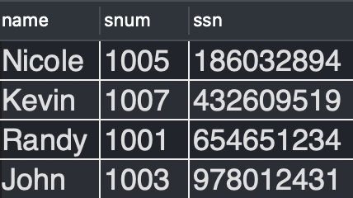
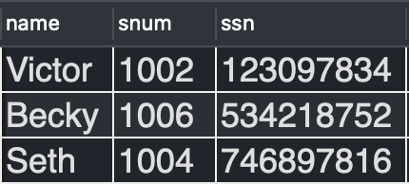
Like (used in a WHERE clause to search for a specified pattern in a column)
The name, snum and SSN of the students whose name contains letter “n” or “N”
SELECT name, snum, ssn
FROM students
WHERE name LIKE '%n%'
or name LIKE '%N%';
The name, snum and SSN of the students whose name does not contain letter “n” or “N”
SELECT name, snum, ssn
FROM students
WHERE name NOT LIKE '%n%'
or name NOT LIKE '%N%';

Slide 18
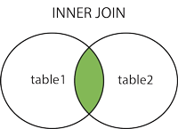
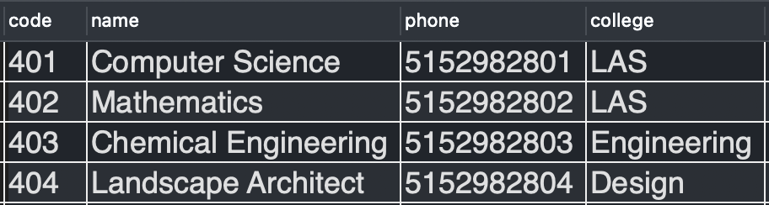
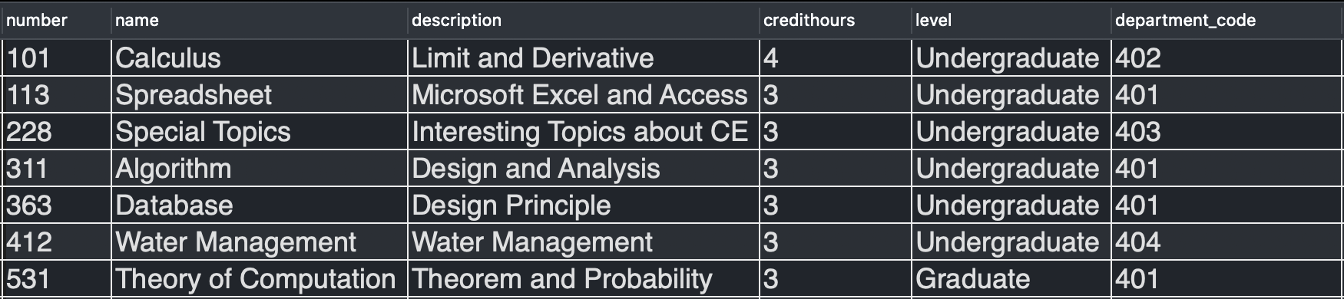
Joins
Find all courses given by the Computer Science department
Department table
Courses table

Slide 19
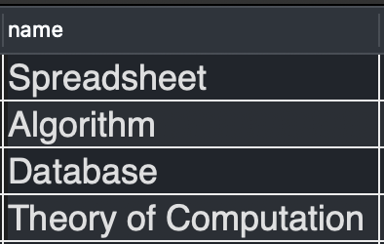
Joins
Find all courses given by the Computer Science department
SELECT c.name
FROM courses c
JOIN departments d on d.code = c.department_code
WHERE d.name = 'Computer Science';

Slide 20
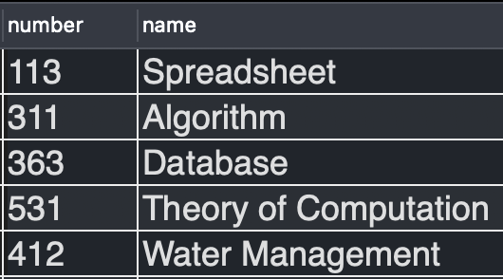
Joins
Find the course numbers and names of all courses offered by either Computer Science Dept or Landscape Architect Dept.
SELECT c.number, c.name
FROM courses c
JOIN departments d on c.department_code = d.code
WHERE d.name = 'Computer Science' or d.name = 'Landscape Architect';

Slide 21
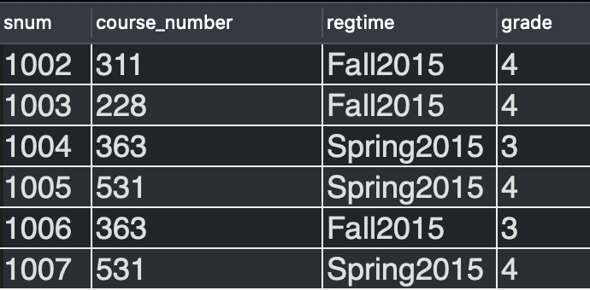
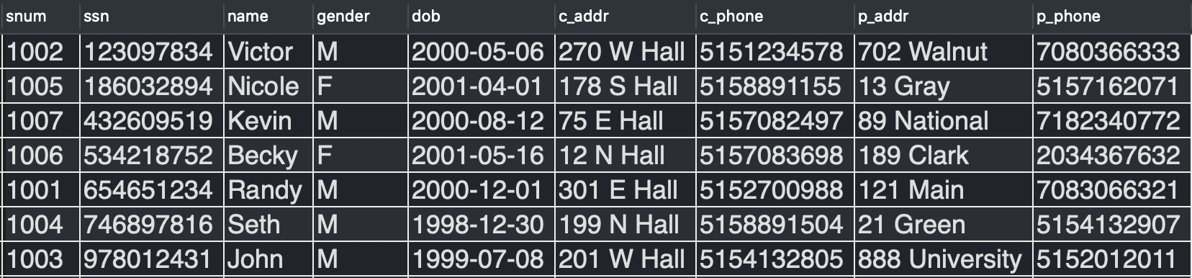
Joins
Find all students registered for Fall 2015
Register table
Students table

Slide 22
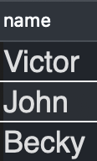
Joins
Find all students registered for Fall 2015
SELECT s.name
FROM students s
JOIN register r on s.snum = r.snum
WHERE r.regtime = 'Fall2015';

Slide 23
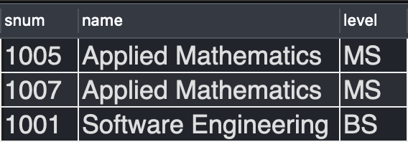
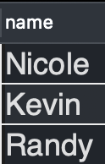
Joins
Find the names of all students who have a minor
SELECT s.name
FROM students s
JOIN minor m on m.snum = s.snum;
Minors table
Result

Slide 24
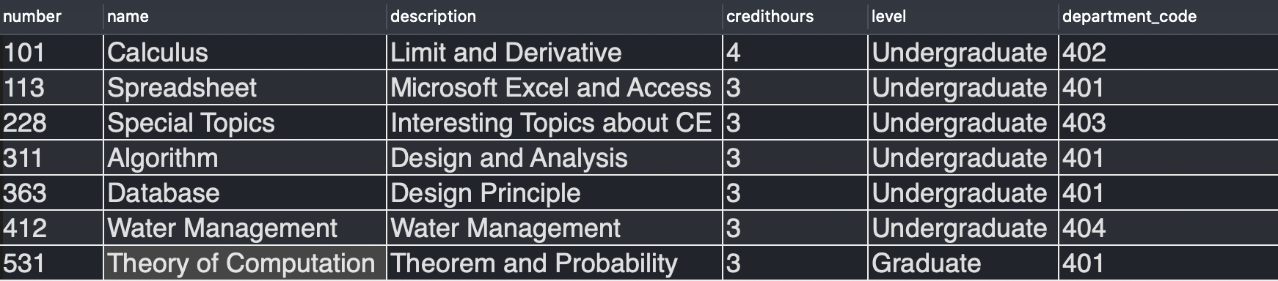
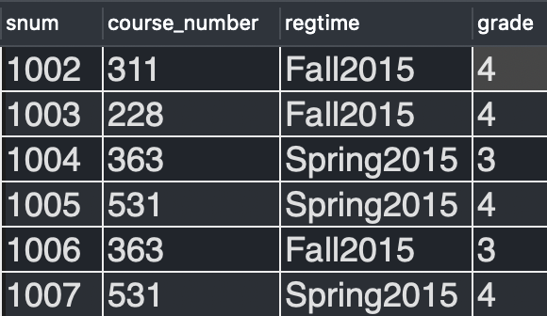
Multiple Joins
Find the names and numbers of all
students enrolled in the course “Algorithms”
Courses table
Register table
Students
table

Slide 25

Multiple Joins
Find the names and numbers of all
students enrolled in the course “Algorithms”
SELECT s.name, s.snum
FROM students s
JOIN register r on r.snum = s.snum
JOIN courses c on c.number = r.course_number
WHERE c.name = 'Algorithm';
Result

Slide 26
More Joins
Find the course number, course name, and number of students registered for each course
Courses table
Register table
Students
table

Slide 27
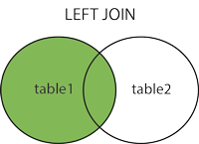
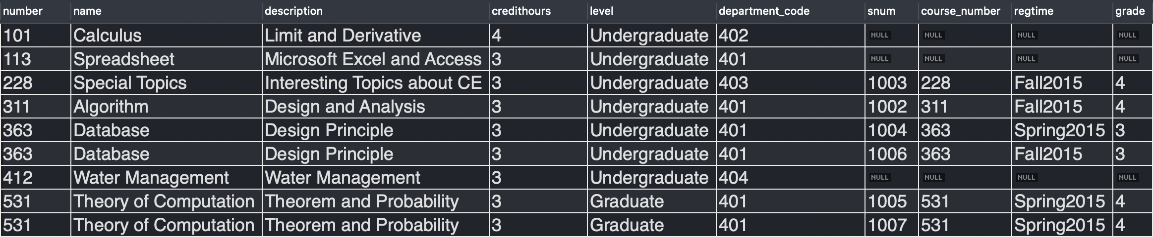
Left Join
A left join returns all records from the left table, and the matched records from the right table
SELECT *
FROM courses c
LEFT OUTER JOIN register r on r.course_number = c.number;

Slide 28
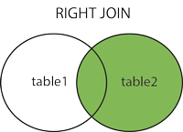
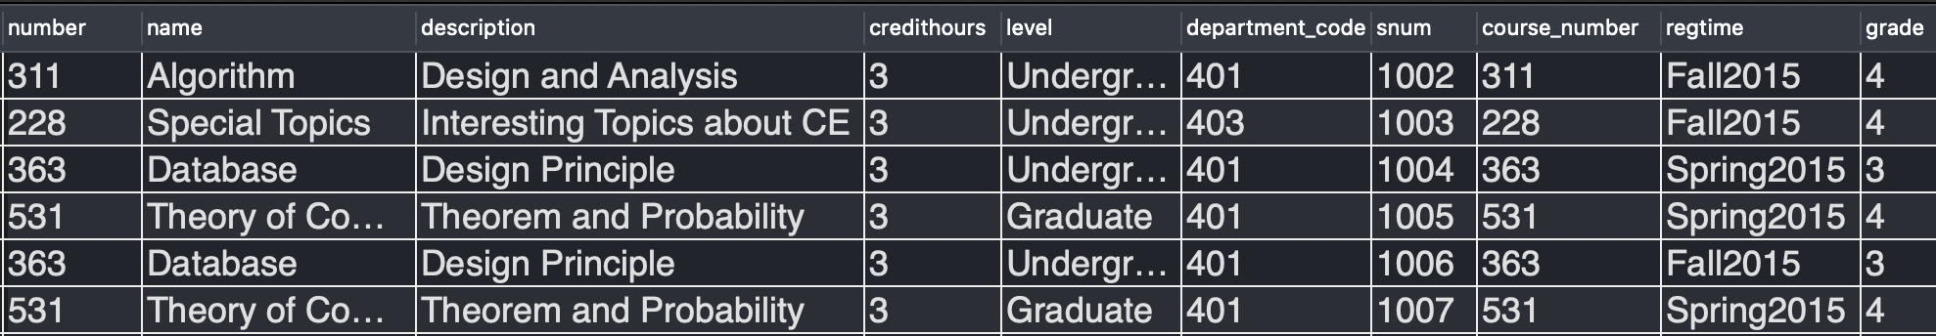
Right Join
A right join returns all records from the right table, and the matched records from the left table
SELECT *
FROM courses c
RIGHT OUTER JOIN register r on r.course_number = c.number;

Slide 29
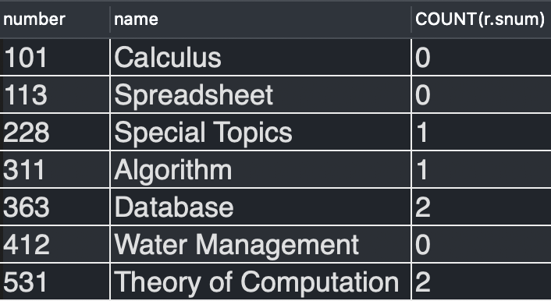
Count + Left Join + Group
Prompt: Find the course number, course name, and number of students registered for each course
SELECT c.number, c.name, COUNT(r.snum)
FROM courses c
LEFT OUTER JOIN register r on c.number = r.course_number
group by c.number;

Slide 30
Nested queries
A nested query is a query that has another query embedded within it (a WHERE clause, a FROM clause and a HAVING clause can contain an SQL query).
The embedded query is called a subquery.
Get the name and snum
of the youngest student.
SELECT name, snum
FROM students
WHERE dob = (
SELECT MAX(dob)
FROM students);
Notes:
Last slide -- show mysql workbench bulk import
show some java code
overview of spring boot

Slide 31
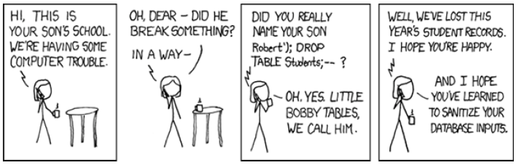
Thank you

